Slide 1

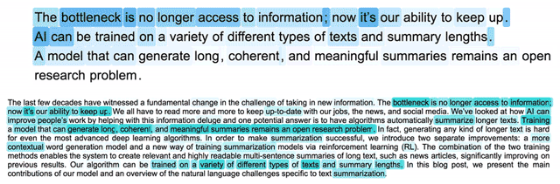
A Deep Reinforced Model for Abstractive Summarization

Slide 2
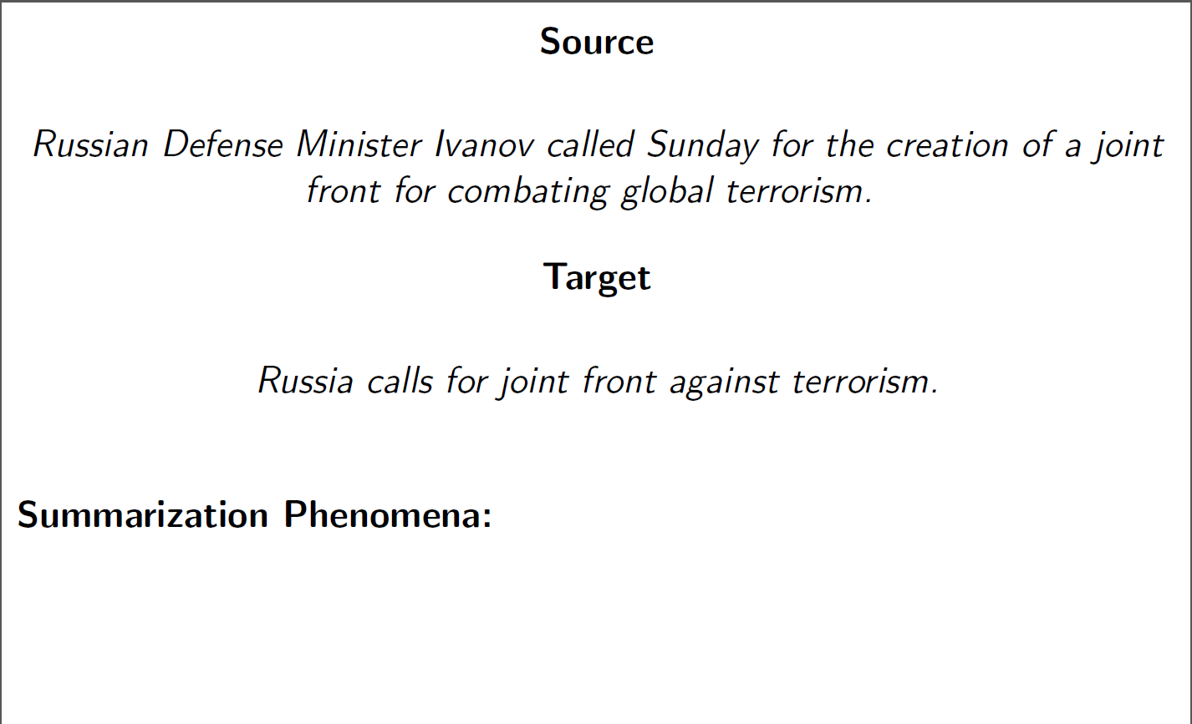
Sentence Summarization

Slide 3
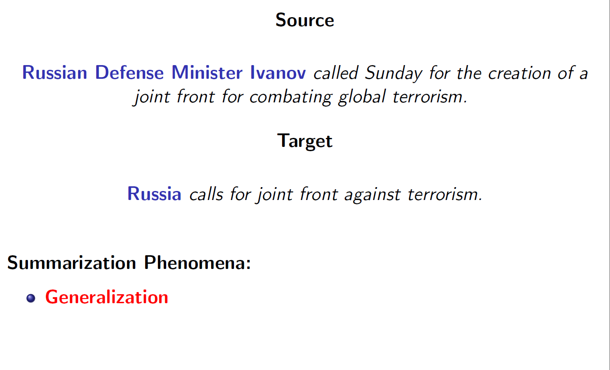
Sentence Summarization

Slide 4
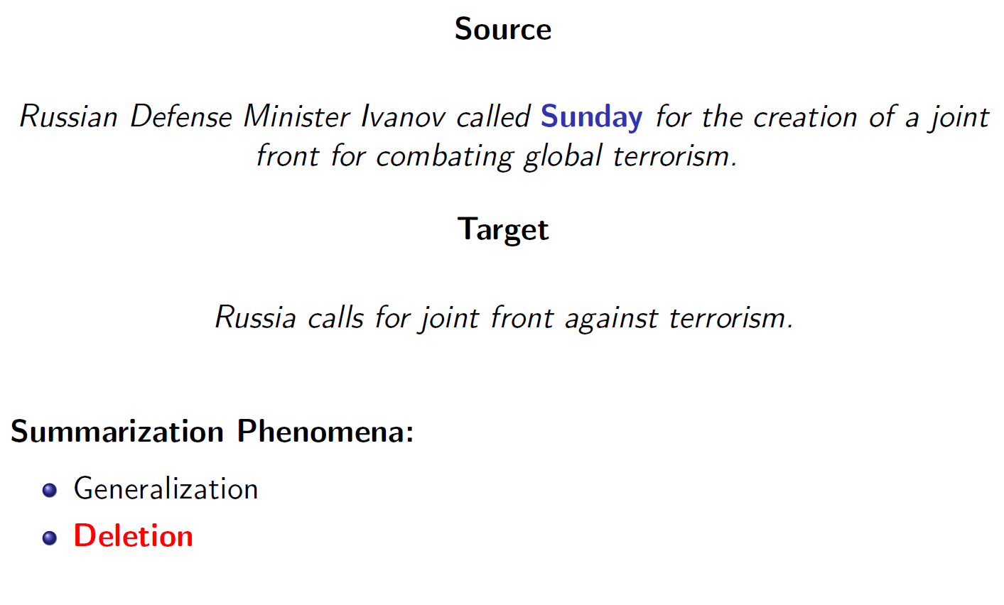
Sentence Summarization

Slide 5
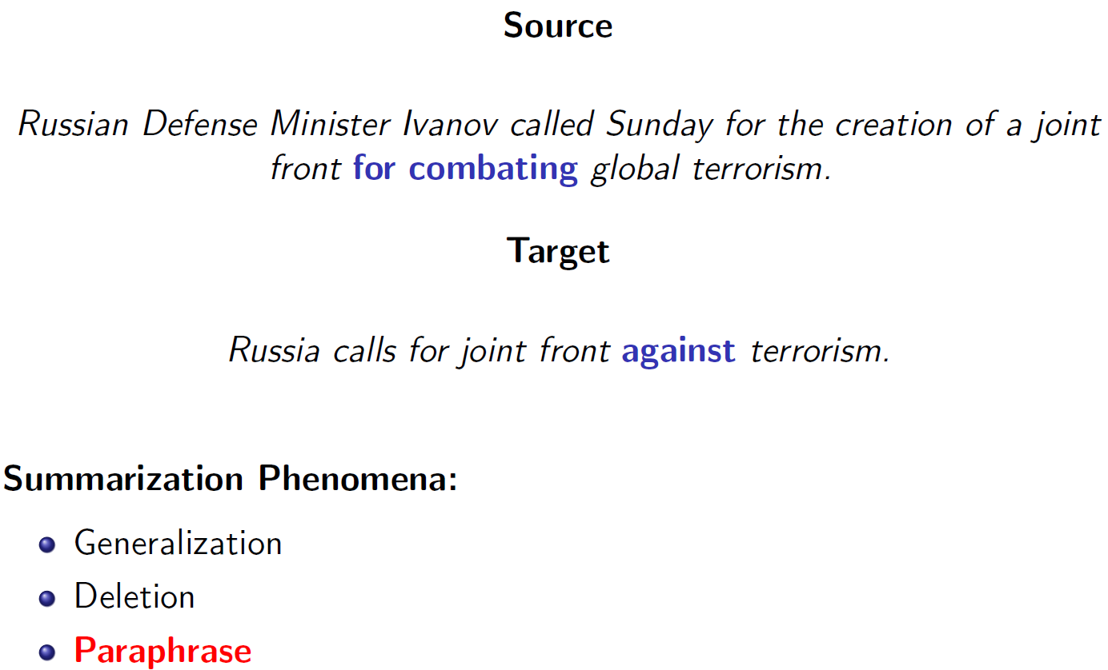
Sentence Summarization

Slide 6
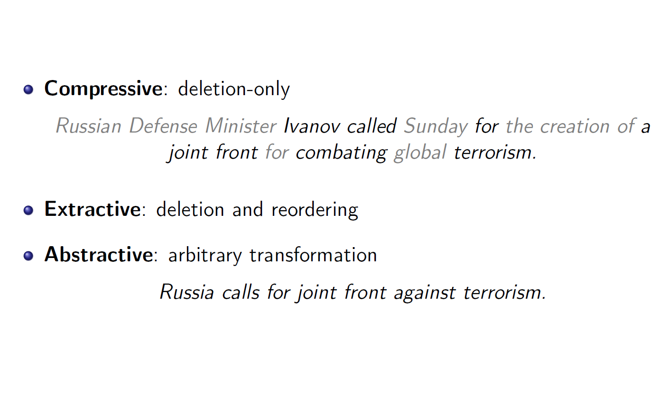
Sentence Summarization

Slide 7
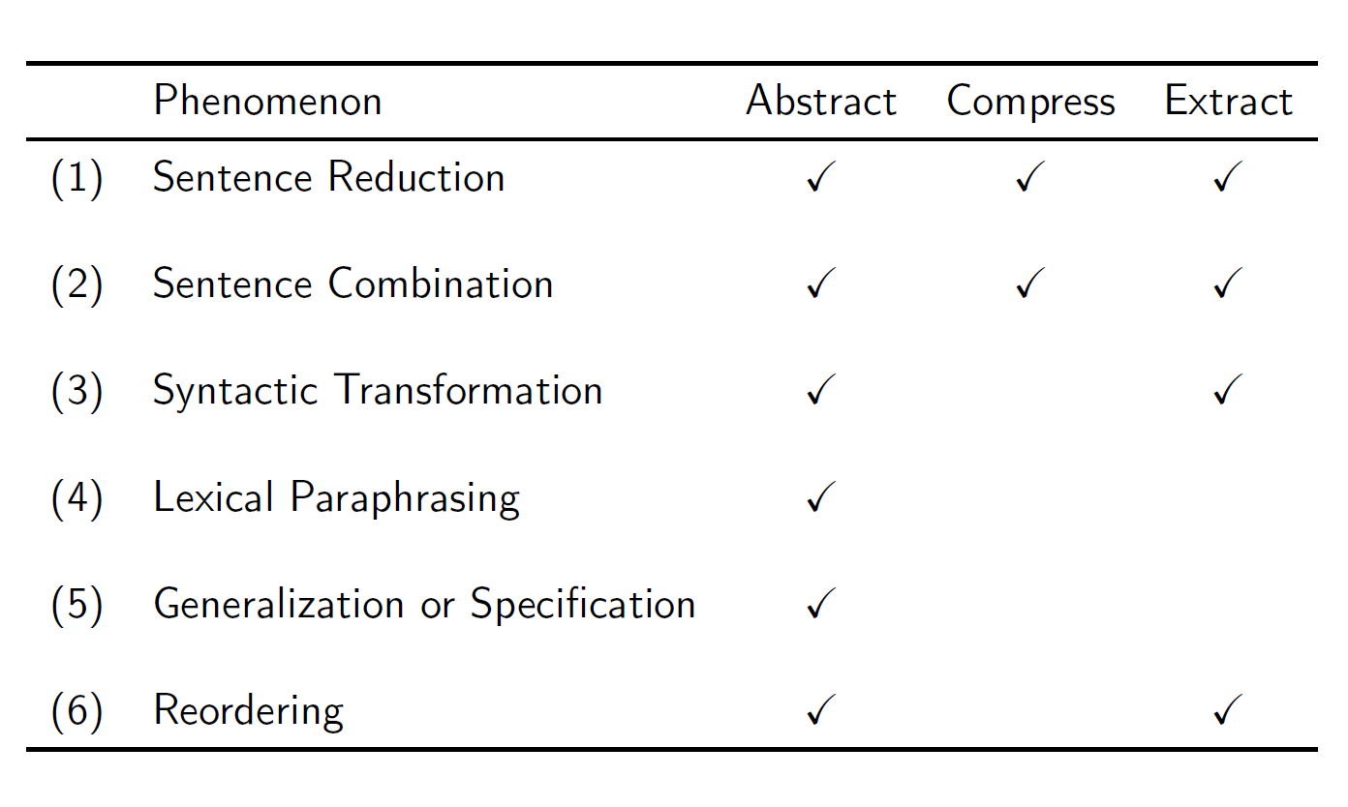
Sentence Summarization

Slide 8
Sentence Summarization
Extractive Summarization:
robust: copy-and-paste
lack in flexibility:
  cannot use novel words or connectors
  cannot paraphrase like people

Slide 9
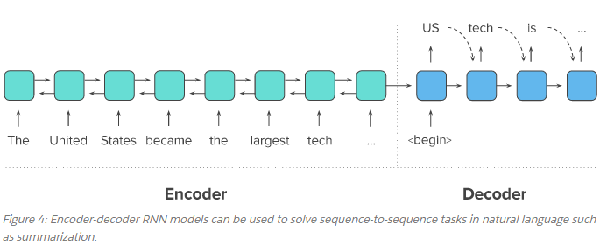
Encoder-decoder Models

Slide 10
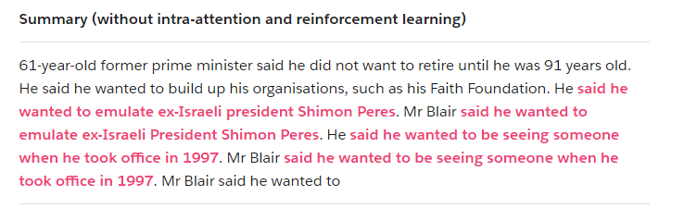
Issues

Slide 11
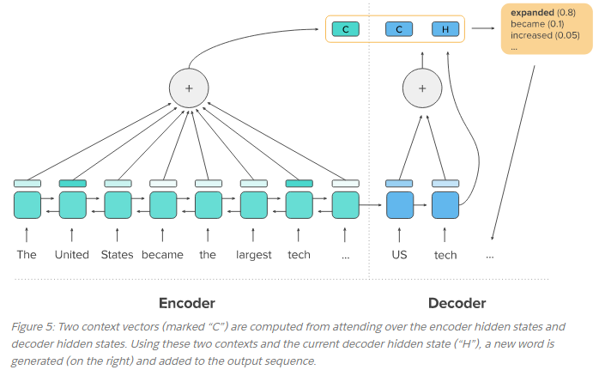
Neural Intra-attention
Model

Slide 12
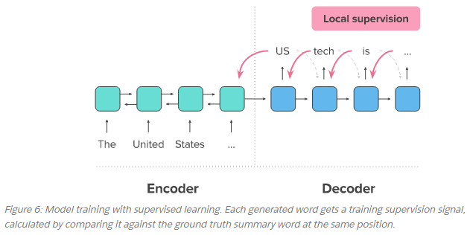
Supervised Learning vs. Reinforcement Learning

Slide 13
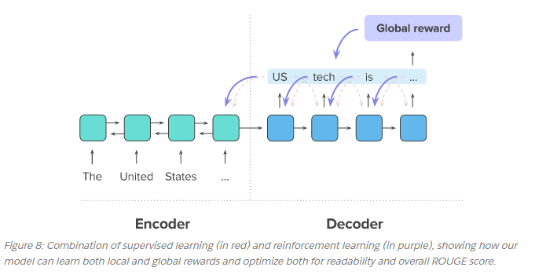
Supervised Learning vs. Reinforcement Learning

Slide 14
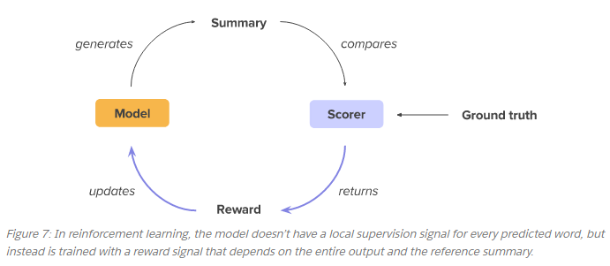
Supervised Learning vs. Reinforcement Learning

Slide 15


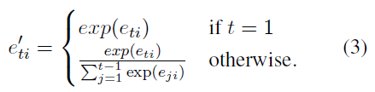
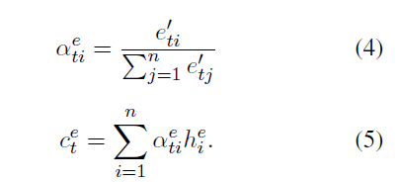
Trick I:
Intra-temporal attention

Slide 16

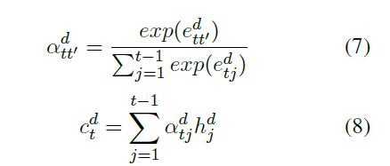
Trick II:
Intra-decoder attention
Avoid repeated phrases, especially when generating long sequences.

Slide 17
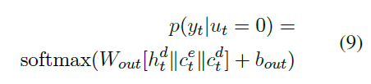

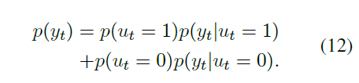
Trick III:
Token generation and pointer
token-generation: softmax layer
pointer mechanism : copy rare or unseen from the input sequence
(OOV, NE)

Slide 18

Trick III:
Token generation and pointer
Sharing decoder weights in token generation
Goal: use the syntactic and semantic information contained in the embedding matrix to improve the token generation function.
converges much faster

Slide 19
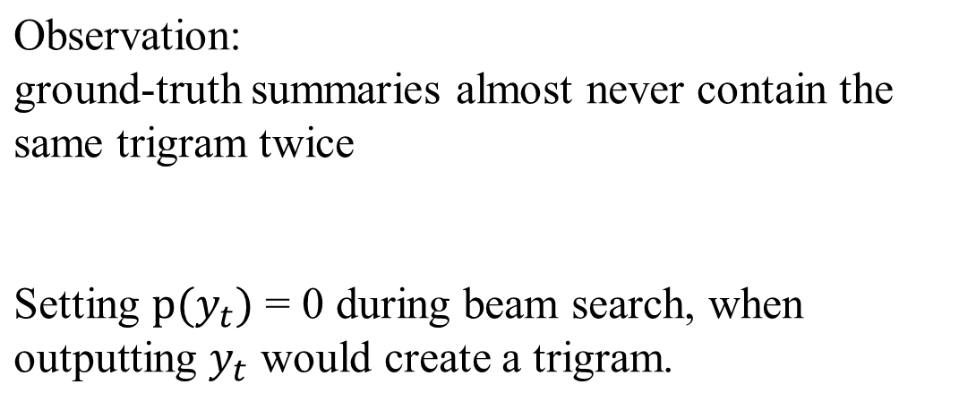
Trick IV:
Repetition avoidance at Test

Slide 20

ML
However, minimizing Lml does not always produce the best results on discrete evaluation metrics such as ROUGE (Lin, 2004).
Exposure bias
Various valid summary
Training:
25% previous generated token instead of ground-truth token

Slide 21



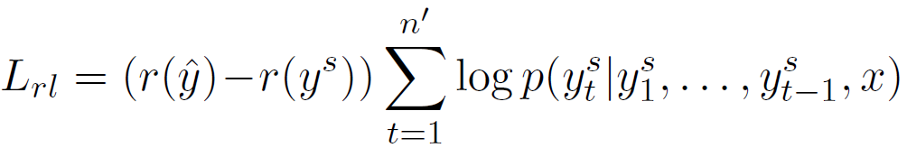
RL
Learn a policy that maximizes a specific discrete metric instead of minimizing the maximum-likelihood loss.
Training
Produce two separate output sequences
  sampling from
  baseline, greedy search
maximizing the output probability distribution at each time step
ROUGE, or Recall-Oriented Understudy for Gisting Evaluation
ROUGE-N: N-gram based co-occurrence statistics.
ROUGE-L: Longest Common Subsequence (LCS) based statistics.
Notes:
Increase the reward expectation

Slide 22

ML + RL
RL optimizing for ROUGE does not guarantee an increase in quality and readability (lm).

Slide 23
Datasets
CNN/Daily Mail
  286,817 training examples, 13,368 validation examples and 11,487 testing examples.
  Input and output lengths: 632 and 53 tokens (or 29.74 and 3.72 sentences).
New York Times
  Random split: 589284 training examples (90%), 32736 validation examples and 32739 testing examples.
  Input and output lengths: 549 tokens, 40 tokens.

Slide 24
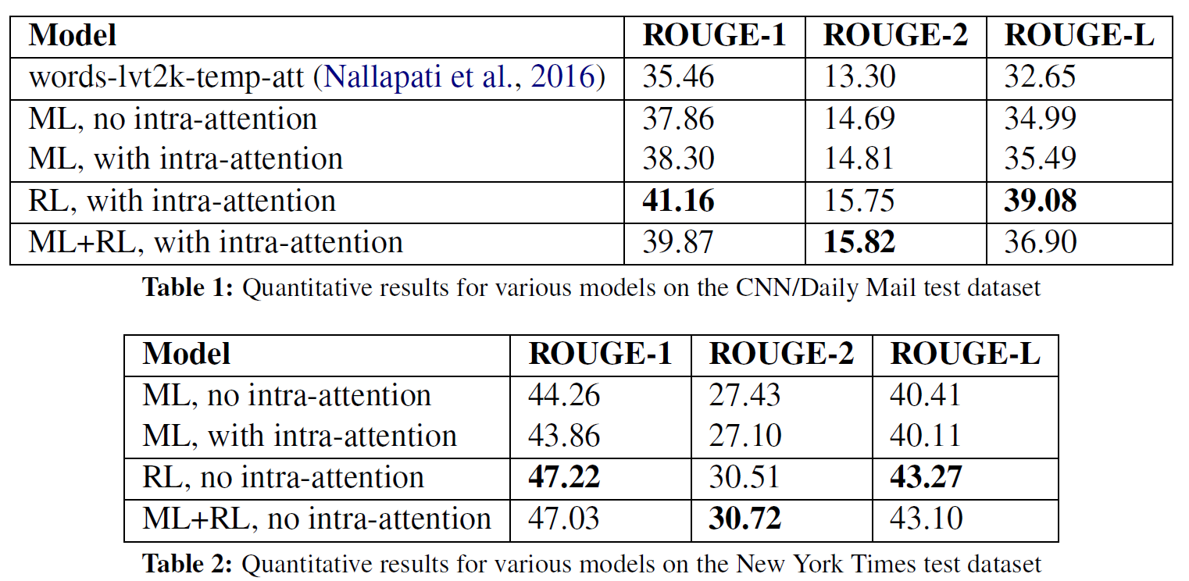
Results

Slide 25
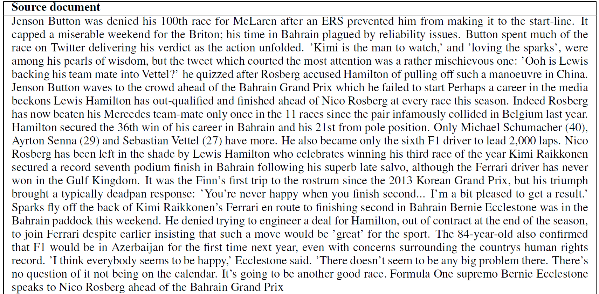

Slide 26
